Slide 1
Explosion Welding
Keith Powell
Michael Fernandez
Staton Burrell

Slide 2
Basics
Explosion welding is a solid-state process that produces a high velocity interaction of dissimilar metals by a controlled detonation
Oxides found on material surfaces must be removed by effacement or dispersion
Surface atoms of two joining metals must come into intimate contact to achieve metallic bond

Slide 3
Advantages
No heat-affected zone (HAZ)
Only minor melting
Material melting temperatures and coefficients of thermal expansion differences do not affect the final product
The shock front compresses and heats the explosive material which exceeds the sonic velocity of undetonated explosives

Slide 4
Component Terminology
Base component
Joined to cladder
Remains stationary
Supported by anvil
Cladding metal
Thin plate in direct contact with explosives
Can be shielded by flyer plate

Slide 5
Flyer plate
Sacrificial plate placed between explosive material and cladder plate
Used to protect cladder metal
Interlayer
Thin metal layer
Enhances joining of cladder to base plate
Anvil
Surface of which the backer rests during explosion

Slide 6
Standoff
Distance between cladder and base plate before explosion
Bond Window
A range of variable in process such as velocity, dynamic bend, and standoff distance that result in successful weld
Bonding Operation
Detonation of explosives that result in a weld

Slide 7
Principle of Explosion
Cladder metal can be placed parallel or inclined to the base plate
Explosive material is distributed over top of cladder metal
Upon detonation, cladder plate collides with base plate to form weld

Slide 8
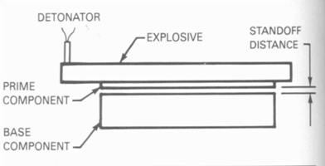
Placement of Cladder metal-parallel
Standoff distance predetermined and unique to material combination
Achieved by placing shims between plates
Shims designed to be consumed by explosion wave and do not affect weld
Usually ranges between 0.5-2 times the thickness of cladder plate
Cladder must reach critical velocity before impact

Slide 9
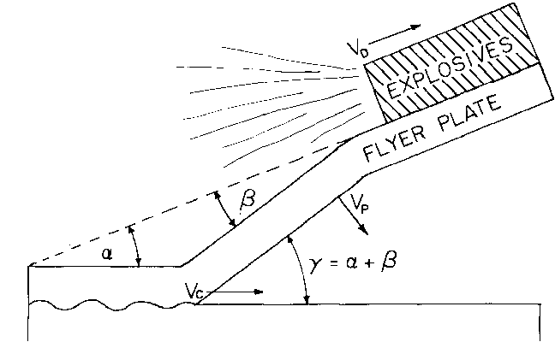
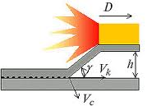
Cladder placement-Angled
VD
Where:
Vc = collision velocity
VD = detonation velocity
Vp = plate Collision velocity
α = preset angle
β = dynamic bend angle
γ = collision angle
Vc
Vp

Slide 10
Explosive material
High velocity (14750-25000 ft/s)
Trinitrotoluene (TNT)
Cyclotrimethylenetrinitramine (RDX)
Pentaerythritol Tetranitrate (PETN)
Mid-low velocity (4900-47500 ft/s)
Ammonium nitrate
Ammonium perchlorate
Amatol

Slide 11
Assuring a good weld
Three types of detonation wave welds
Shock wave develops if sonic velocity is greater than 120% of material sonic velocity (type 1)
Detached shock wave results when detonation velocity is between 100% and 120% of material sonic velocity (type 2)
No shock wave is produced if detonation velocity is less than material sonic velocity (type 3)

Slide 12
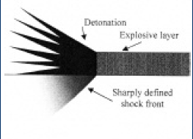
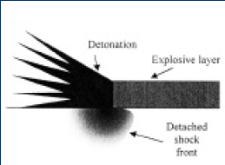
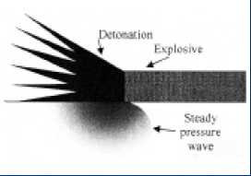
Assuring a good weld
Type 1
Material behind shock wave is compressed to peak pressure and density
Creates significant plastic deformation locally and results in considerable ‘shock hardening’
Type 2 & 3
Pressure is generated ahead of collision point of metals
When subject to large pressures, metal ahead of collision point flows into spaces between plates and takes form of high-velocity jet
Effaces material and removes unwanted oxides and other unwanted surface films
No bulk diffusion and only localized melting

Slide 13
Assuring a good weld
Detonation velocity is a function of
Explosive type
Composition of explosive
Thickness of explosive layer
Can be found in tables

Slide 14
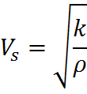
Assuring a good weld
Sonic velocity of cladding material can calculated using:
Where:
K = adiabatic bulk modulus
ρ = cladding material density
E = Young’s Modulus of cladding material
ע = Poisson’s ratio of cladding material

Slide 15
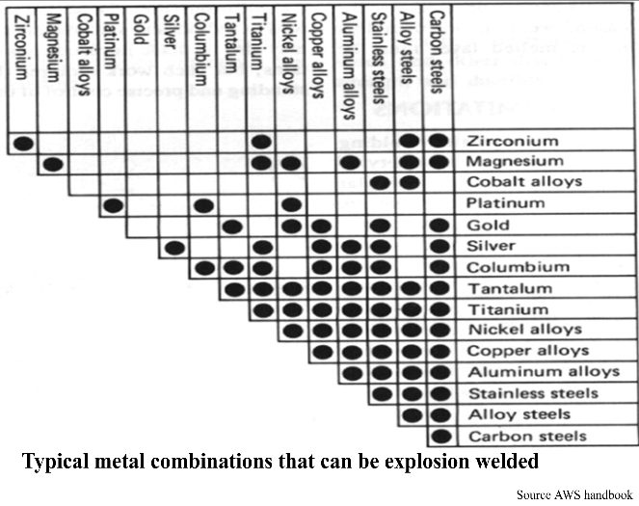
Applications
Any metal with sufficient strength and ductility can be joined

Slide 16
Applications
Can weld large areas of metal
Can weld inside and outside surfaces of pipes
Transition joints can be made

Slide 17
History
Arnold Holtzman and a team at DuPont in Delaware put a lot of research into developing the process.
Holtzman filed for a US patent in 1962 for explosion welding, received the patent in 1964 and began commercial production of bi-metallic explosion welded clad in 1965.
Detaclad licensed the process and was bought by Dynamic Materials Corporation (DMC).
Other companies have merged with DMC and acquired the current name DMC Groupe SNPE making them a worldwide company.
Notes:
US locations: colorado, pennsylvania, connecticut.
Europe locations: France, Germany, Sweden

Slide 18
Common industries that use explosion welding
Chemical Processing
Petroleum Refining
Hydrometallurgy
Aluminum Smelting
Shipbuilding
Electrochemical
Oil & Gas
Power Generation
Cryogenic Processing
Pulp & Paper
Air conditioning & Chillers
Metal Production

Slide 19
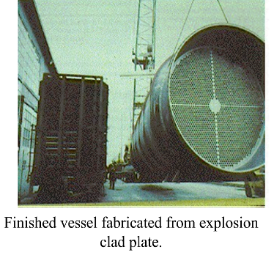
Examples

Slide 20
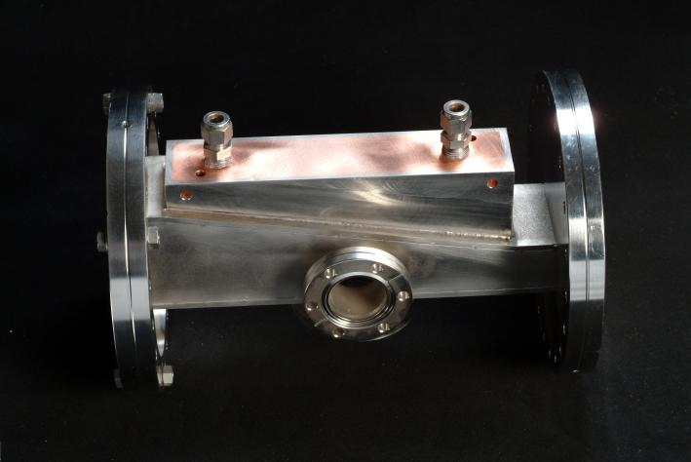
Examples
3” Diameter AI/SS Ring
Copper/Stainless 12” UHV Assembly

Slide 21
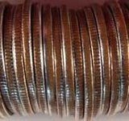
Examples
United States dimes and quarters are presently a clad “sandwich” of copper inner-core and a silver-colored nickel-copper alloy

Slide 22
Works Cited
http://www.annualreviews.org/doi/pdf/10.1146/annurev.ms.05.080175.001141
http://www.authorstream.com/Presentation/rock354-421051-explosive-welding-final-unconventional-machining-mp-iii-education-ppt-powerpoint/
Young, G (2004). "Explosion Welding, Technical Growth and Commercial History" (PDF). Dynamic Materials Corporation. http://www.dynamicmaterials.com/data/brochures/1-%20Young%20Paper%20on%20EXW%20History.pdf. Retrieved 2010-11-29

